Slide 1
High resolution CT-based characterization analysis of idiopathic pulmonary fibrosis
Yuwen Zhang, Merryn Tawhai, Alys Clark, Haribalan Kumar
David Milne, Margaret Wilsher, Brian Bartholmai
Notes:
Good morning, everyone, I’m Yuwen Zhang, from Auckland Bioengineering Institute. Thank you very much for coming to my presentation. Next, I will introduce my research project, it’s about CT-based characterization analysis of idiopathic pulmonary fibrosis

Slide 2
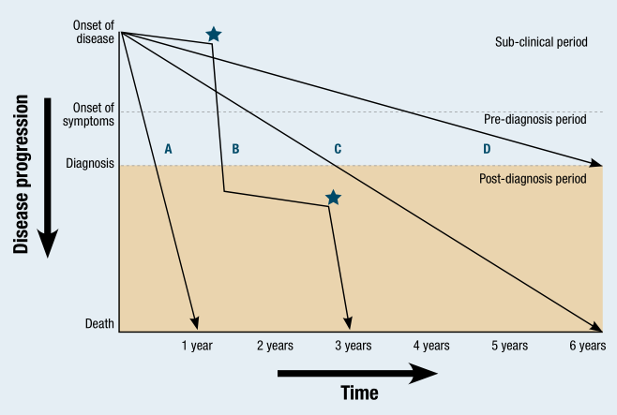
Background
Idiopathic pulmonary fibrosis (IPF) is a chronic and life-threatening disease
Cause is unknown
Etiology remains elusive
Progression is variable and unpredictable
Notes:
IPF is one of the most aggressive and frequent forms of idiopathic lung disease. Idiopathic means that the cause is unknown. For people more than 75 years old, IPF is estimated to occure in more than 200 cases per 1000,000. That is a large number of people, and a mean survival of only approximately 3 years. The rate of progression of IPF is quite variable and unpredictable between patients. However, there are currently no reliable biomarkers that can indicate the likely progression of IPF disease.

Slide 3
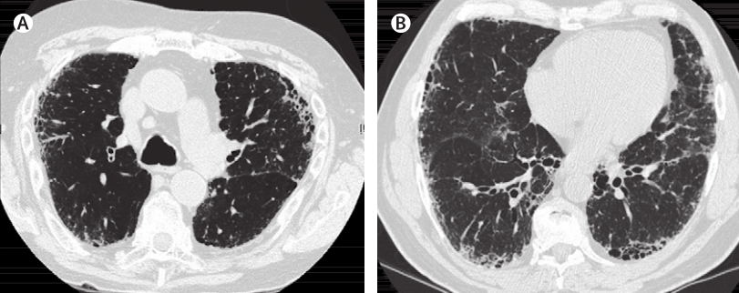
Background
HRCT is an essential tool in evaluating lung disease
Associated with the presence of a usual interstitial pneumonia (UIP) pattern on HRCT (ATS/ERS criteria)
Honeycomb, reticular, ground-glass
Notes:
With the development of radiological imaging techniques, high-resolution computed tomography (HRCT) has played an essential role in evaluating lung disease. Based on the criteria set by members of ATS / ERS, the diagnosis of IPF usually associates with the presence of a usual interstitial pneumonia (UIP) pattern on HRCT. Honycomb, reticular and ground-glass are all typical CT patterns of fibrosis disease. In addition, in the past ten years, some researchers suggest that combined IPF and emphysema (CPFE) should be regarded as a distinct clinical entity other than emphysema or IPF alone.

Slide 4

Aim
Aim
Currently published work:
Quantitative analysis of radiological images
Clinical functional measurements
Quantitative analysis on volumetric CT
Pulmonary functional tests
Radiological images may be not sufficient enough to explain the decline of lung function
Limited research into combining spatial data with functional data.
No established quantitative tools to assess the progression of IPF
Computational models:
IPF lung function
IPF diagnosis, treatment and progression prediction
Notes:
In the past few years, there has been effort to provide quantitative analysis on CT scans of lung parenchymal abnormalities, and also some statistical analysis of clinical data from IPF patients, such as PFT data, airway resistance, tissue compliance and ventilation/perfusion ratio. But, usually, radiological imagegs are not sufficient enough itself to explain the decline of lung function. There are few researches involves in relating CT spatial distribution of abnormalities to the functional data. And there is no established quantitative tools exist to assess the progression of IPF. So the aim of our study is to use the quantitative disease information extracted from volumetric CT, combining with PFT data, to parameterize our computational models of lung function, use the functional simulation results to help with IPF clinical diagnosis, treatment and the prediction of IPF progression.

Slide 5
Imaging and clinical data
Clinical data assessed in this study
Age (years) | 43-82
Females/Males | 3/5
Slice thickness (mm) | 1.25-3.00
Interval between scans (months) | 5-20
Slice resolution | 512x512
Number of slices | 65-160
The clinical data used in this study comprised HRCT images and pulmonary function tests obtained from 8 patients diagnosed with IPF at Auckland City Hospital, Auckland, New Zealand.
5 patient 1 time point
1 patient 2 time point
2 patient 3 time point
Notes:
The clinical CT data used in this study was acquired from 8 patients diagnosed with IPF at Auckland City Hospital. The slice thickness of these clinical CT images are from 1.25 to 3.00mm. Among these data, 5 patients have one time point, 1 patient has 2 time point data, 2 patients have time point data. The time interval between different time point is between 5 to 20 monts.

Slide 6
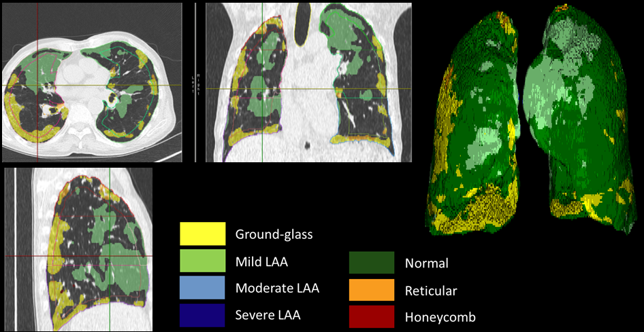
Pulmonary parenchymal classification
CALIPER (Computer-Aided Lung Informatics for Pathology Evaluation and Ratings) software.
Mayo Clinic (Rochester, MN, USA)
Each parenchymal voxel was classified into the following characteristic CT patterns: normal (N), reticular (R), honeycomb (HC), ground-glass (GG), mild low attenuation areas (LAA), moderate LAA and severe LAA. Emphysema : Hounsfield Unit is under -950.
a
b
d
c
Color labelled classification result of case 7 on IPF HRCT by CALIPER. (a) Transverse plane. (b) Coronal plane. (c) Sagittal plane. (d) 3D color labelled lung.
By. Brian Bartholmai
Notes:
Tissue regions were classified using CALIPER (Computer-Aided Lung Informatics for Pathology Evaluation and Ratings) software, developed at the Mayo Clinic. This software is able to classify every lung parenchymal voxel into several kinds of CT patterns, including normal (N), reticular (R), honeycomb (HC), ground-glass (GG), mild low attenuation areas (LAA), moderate LAA and severe LAA. In addition, emphysema areas were extracted through detecting the voxels whose Hounsfield Unit is under -950.

Slide 7
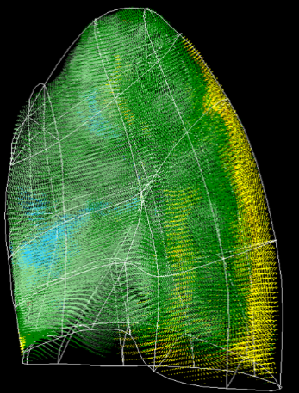
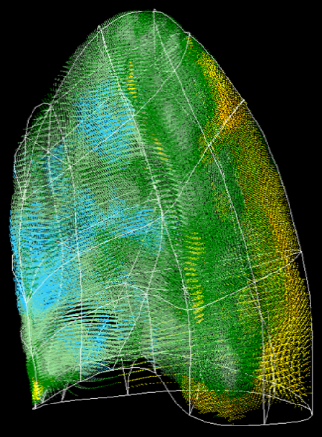
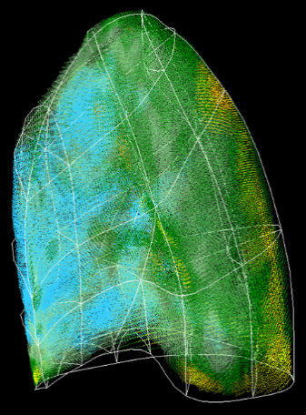
Normalization of classified data
Lung mesh : bi-cubic Hermite finite element surface mesh (left lung: 35 nodes and 44 elements; right lung: 50 nodes and 62 elements)
Classified data mapping : statistical shape model (SSM), principal component analysis (PCA)
Time point 1 Time point 2 Time point 3
Notes:
Lung surface data was extracted from the classified data and fissure surfaces were defined manually using the open-source visualization software CMGUI by an expert user. A bi-cubic Hermite finite element surface mesh was fitted to the shape of the lung and its fissures. Since there is lung shape variation between different subjects and often between clinical images obtained at different times. Classified volumetric lung data was then mapped to a statistical shape model (SSM) of the ‘normal’ older human lung. The statistical shape model was constructed based on principle component analysis derived from a set of training meshes. The gaps on the mapped data was filled using KNN searching to make it easier for the further quantitative analysis.

Slide 8
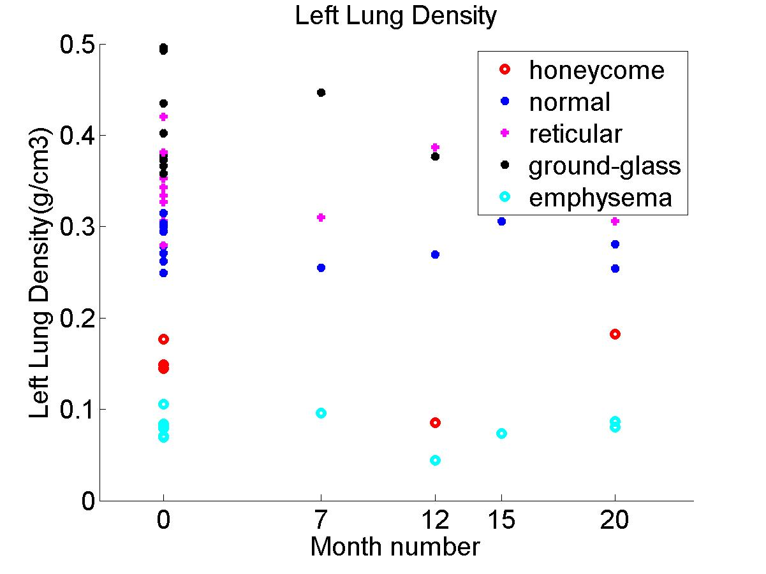
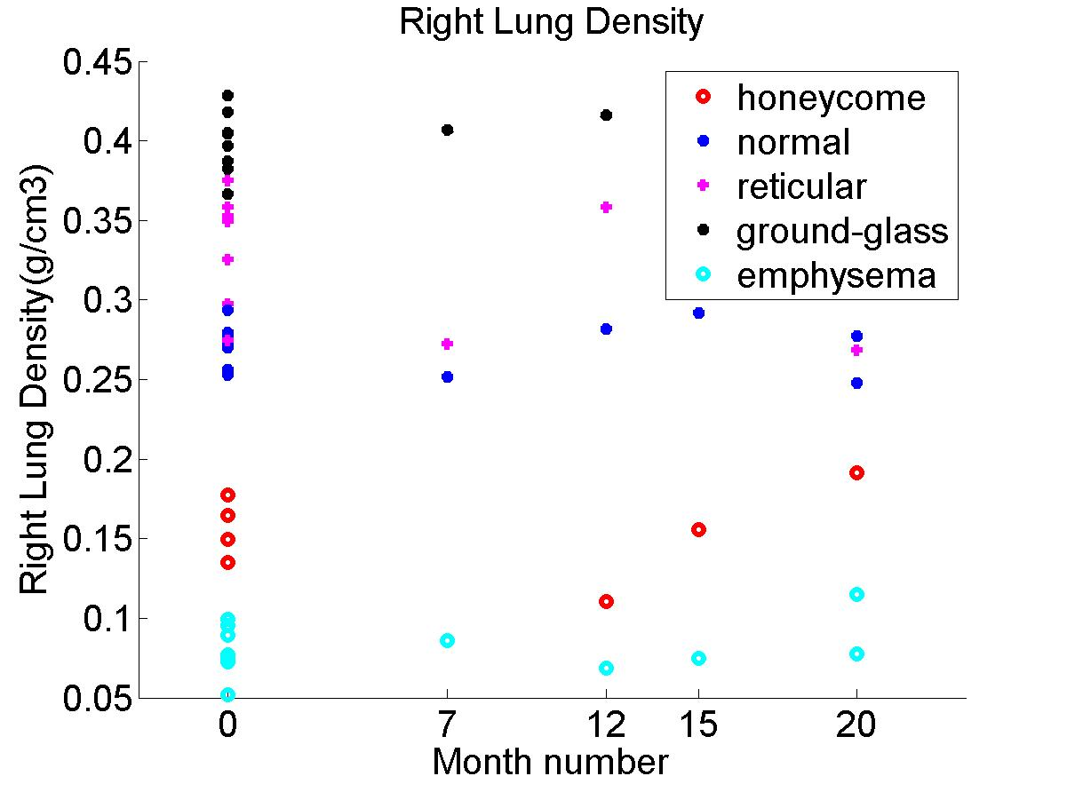
Density analysis
Fibrosis usually has a consistently higher tissue density (0.34/0.41 for reticular/ground-glass) compared to normal tissue (0.27) over time
In contrast, emphysema has lower density (0.078)
Notes:
Using the classified data, we can have a quanlification of different tissue density. The average tissue density of each classified CT pattern was calculated. From the result, we can see fibrosis has a consistently higher tissue density (0.34/0.41 for reticular/ground-glass) over time compared to normal tissue (0.2752). In contrast, emphysema has lower density (0.0784). These result could help us quantify tissue density of the mechanical model.

Slide 9
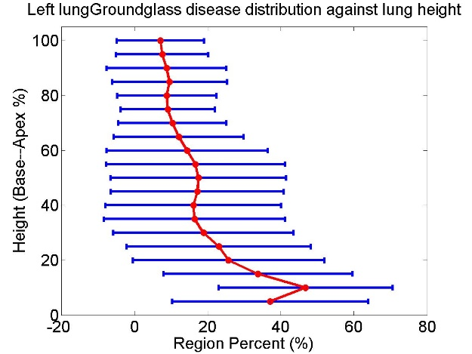
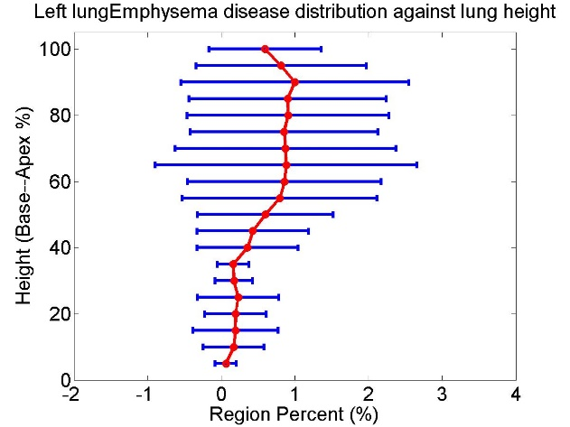
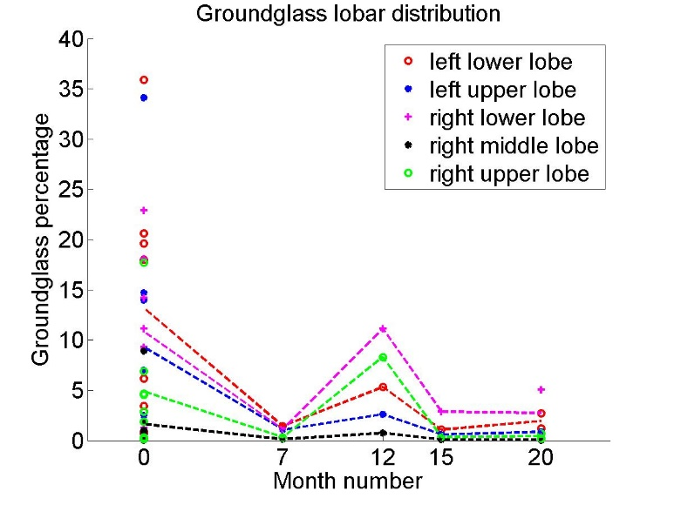
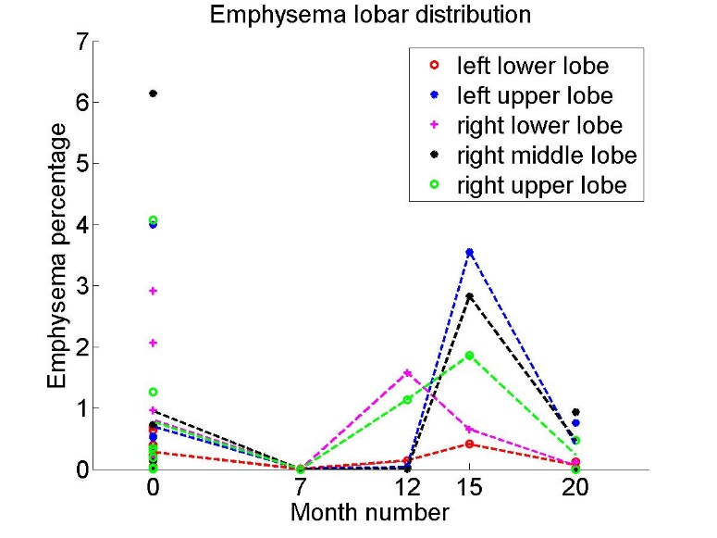
Spatial distribution analysis
Ground-glass
Emphysema
Fibrosis mostly located in lower lobes (72%, 58%, 65% for honeycomb, reticular, ground-glass)
Emphysema mostly located in upper lobes (73%)
Notes:
In order to analyze the spatial distribution of abnormalities, the volume percent of each kind of disease pattern was averaged withinin 5% lung height in the direction from base to apex. Also, the volume percent of each disease pattern for each lobe was calculated to provide a lobar distribution of disease. We can see from the result that fibrosis mostly located in lower lobes (72%, 58%, 65% for honeycomb, reticular, ground-glass). In contrast, Emphysema mostly located in upper lobes (73%). The spatial distribution of disease is an important index when we label the disease region in our functional model.

Slide 10
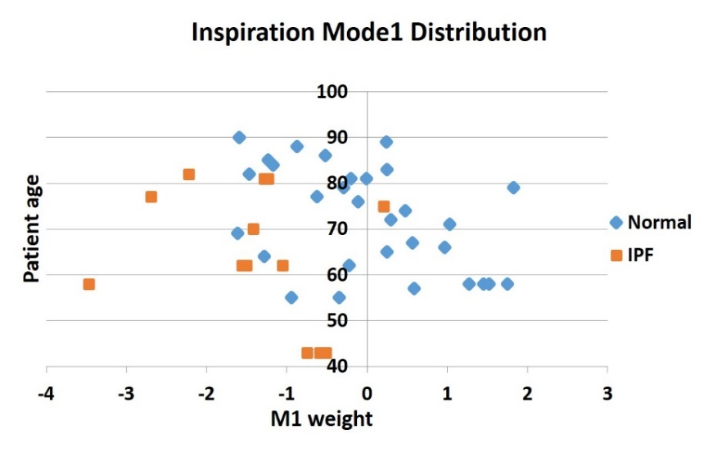
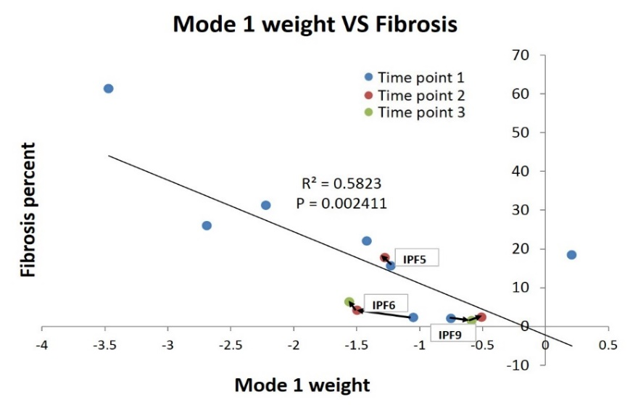
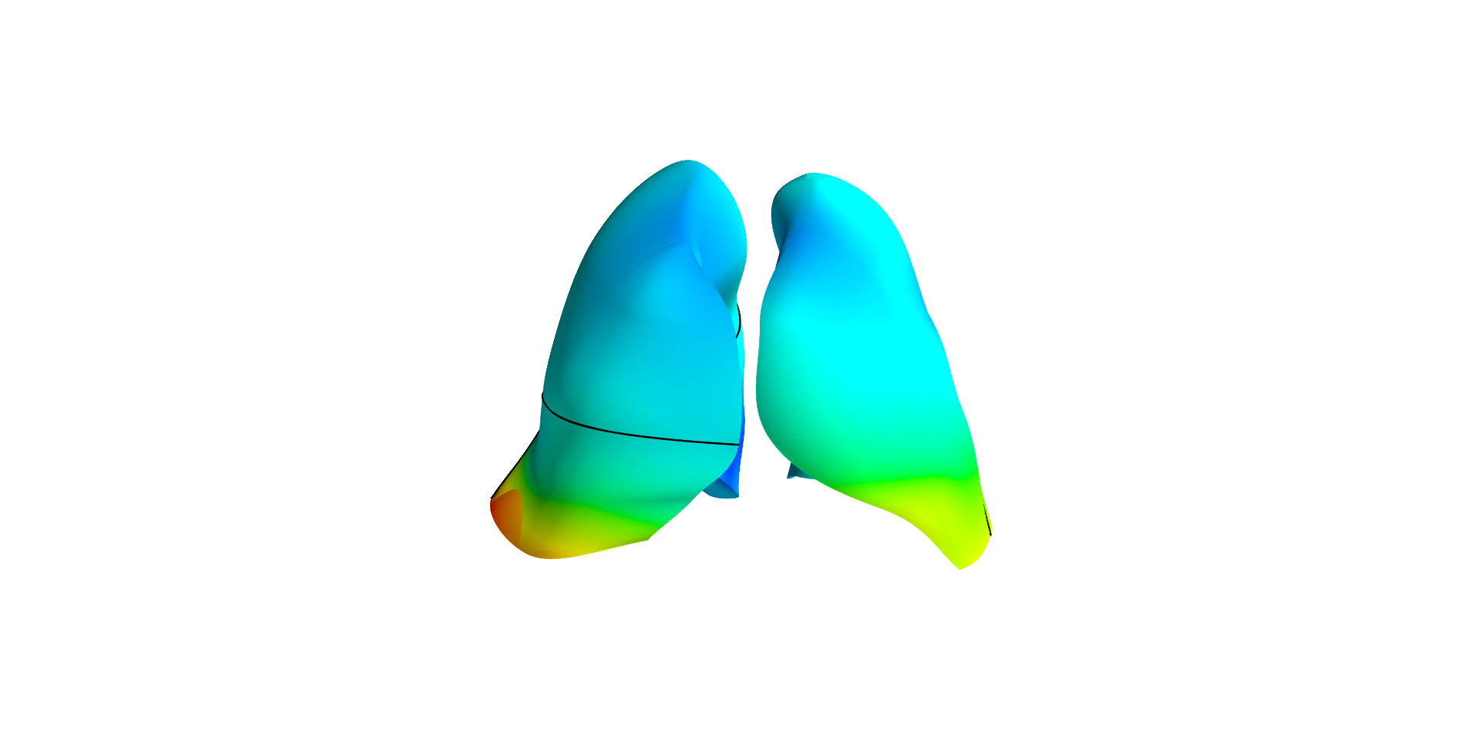
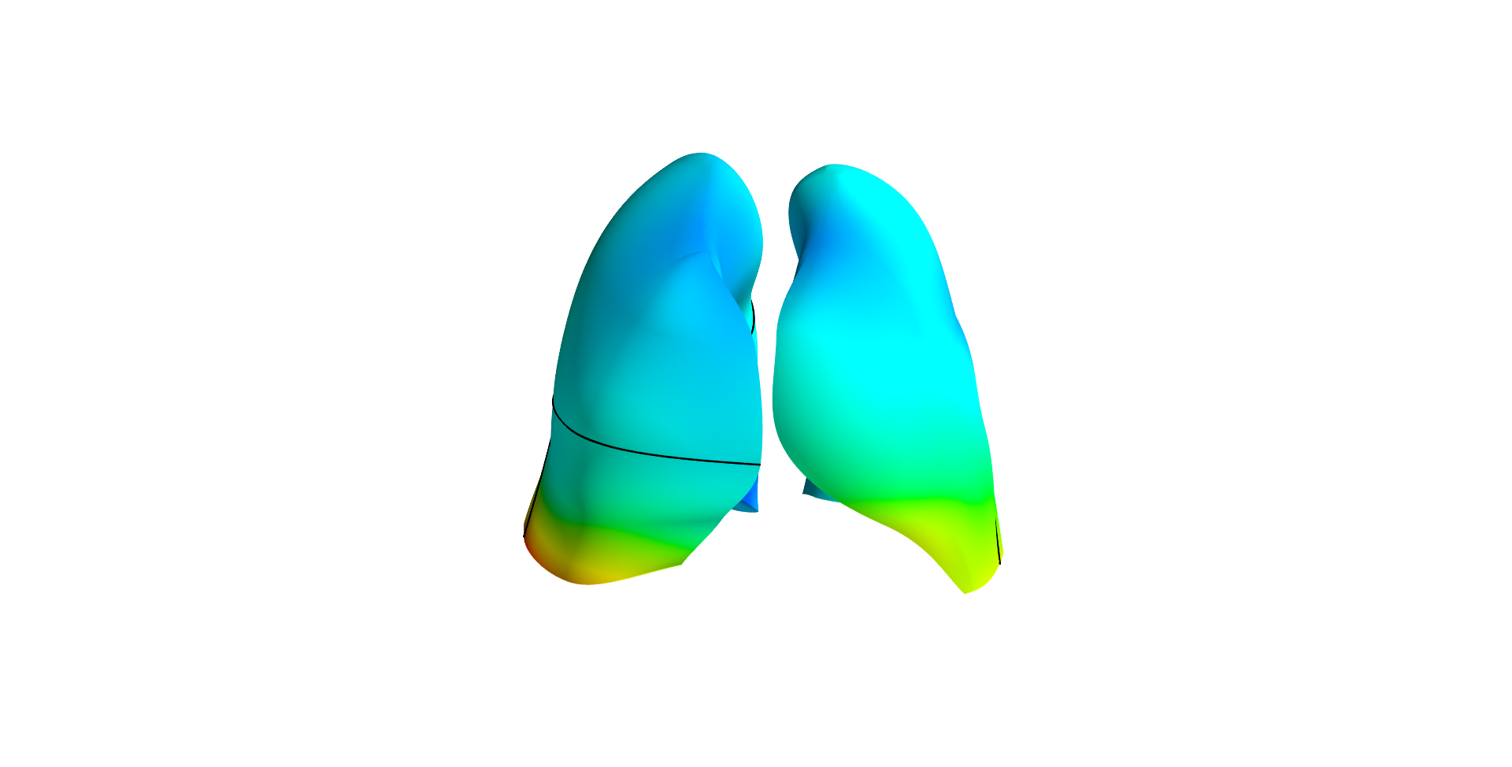
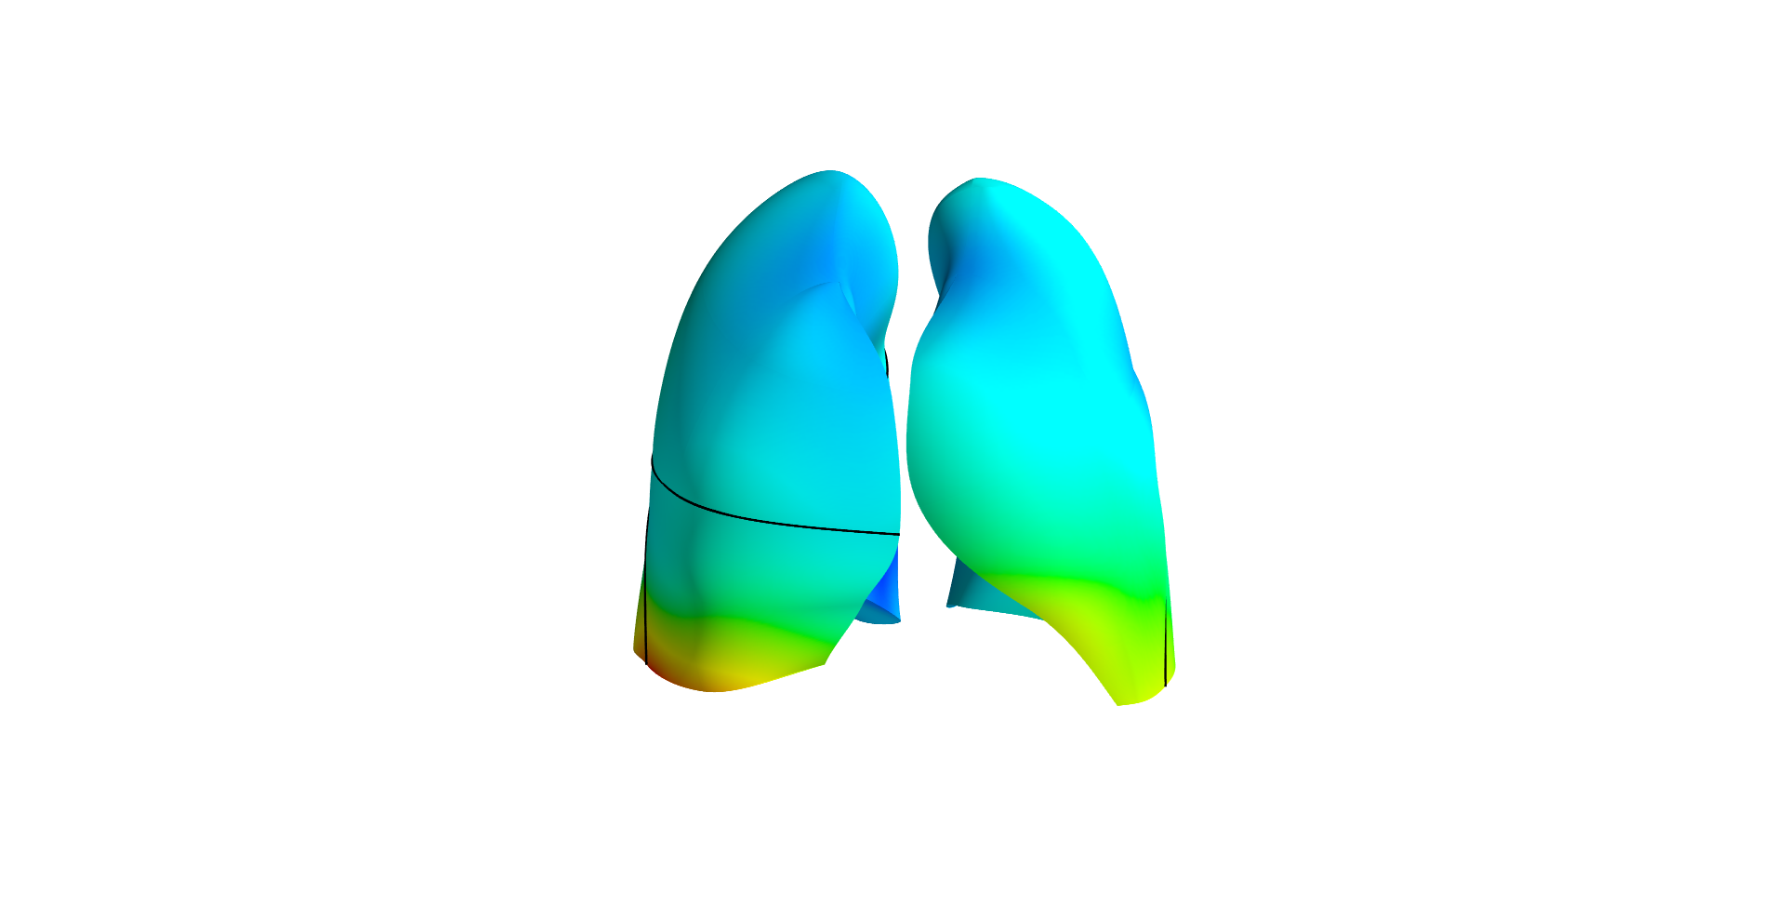
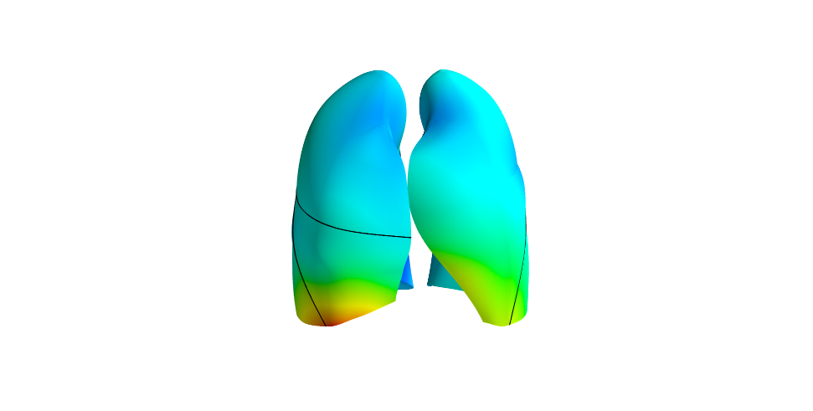
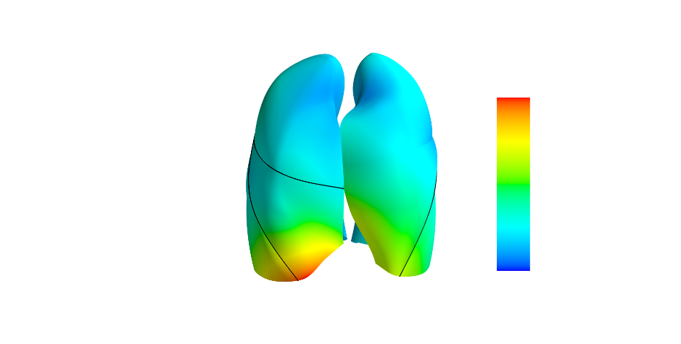
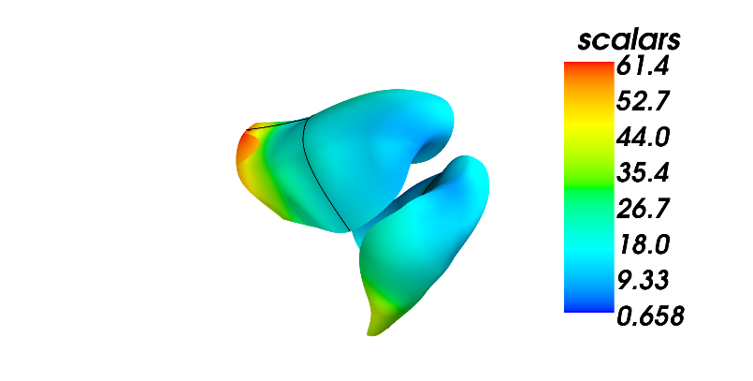
SSM based shape analysis
Training data collection
(35 older normal)
Principle component shape feature analysis
Statistical shape model construction
Specific subject projection
Mode1 -3
Mode1 -2
Mode1 -1
Mode1 1
Mode1 3
Notes:
Next, we compared the IPF lung shape to the old normal ones. In order to analyze the lung shape difference, we also used the PCA-based SSM which is constructed using the same way as we introduced previously. The only difference is here we used 35 old normal subjects as the training set. By making use of PCA analysis, we are able to decompose lung shape into a set of mode, each mode represents a kind of shape variation. Here, we projected each IPF lung to the SSM, so that we can get the weight value for each mode. We found that there is a significant differece of the first mode between IPF lungs and old normal lungs. The first mode captures over 20% of the entire shape variation, it mainly describes the change of the anteroposterior diameter of the lung, and the ratio of apical and basal diameters. Also, there is a strong relationship between the first mode and the fibrosis percentage. That means with the progression of IPF, the abnormalities could cause a shape change of lung, and this kind of change has a relationship with the fibrosis overall percent.

Slide 11
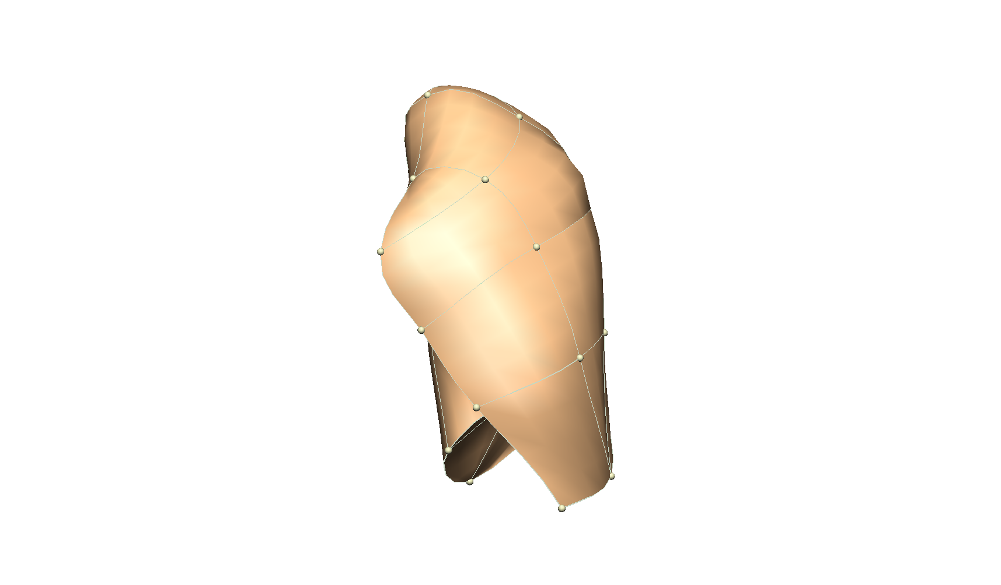
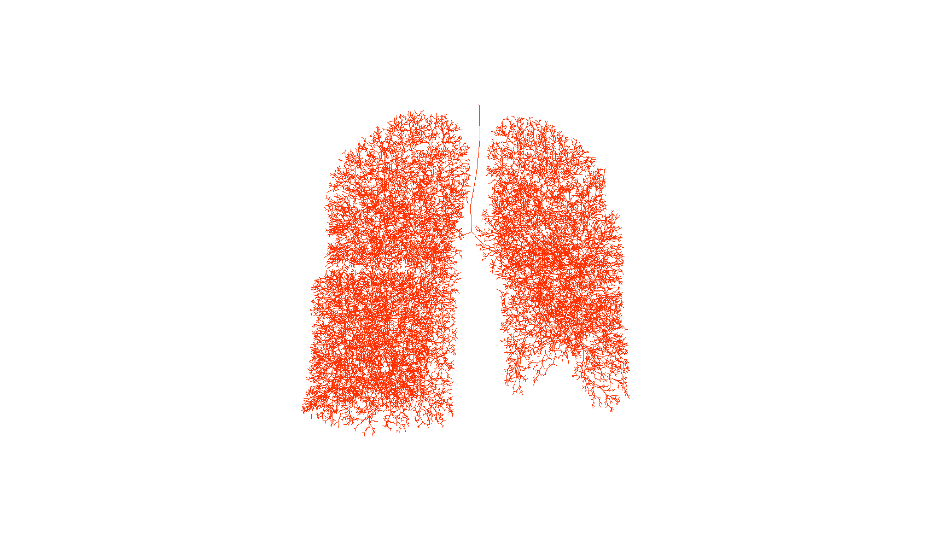
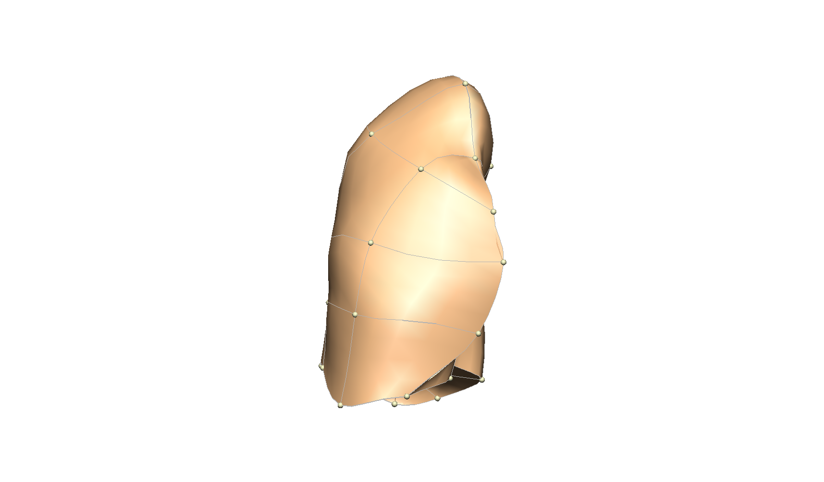
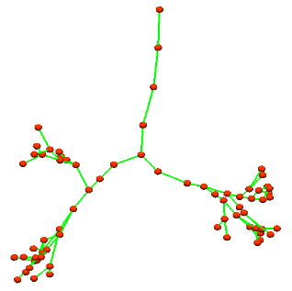
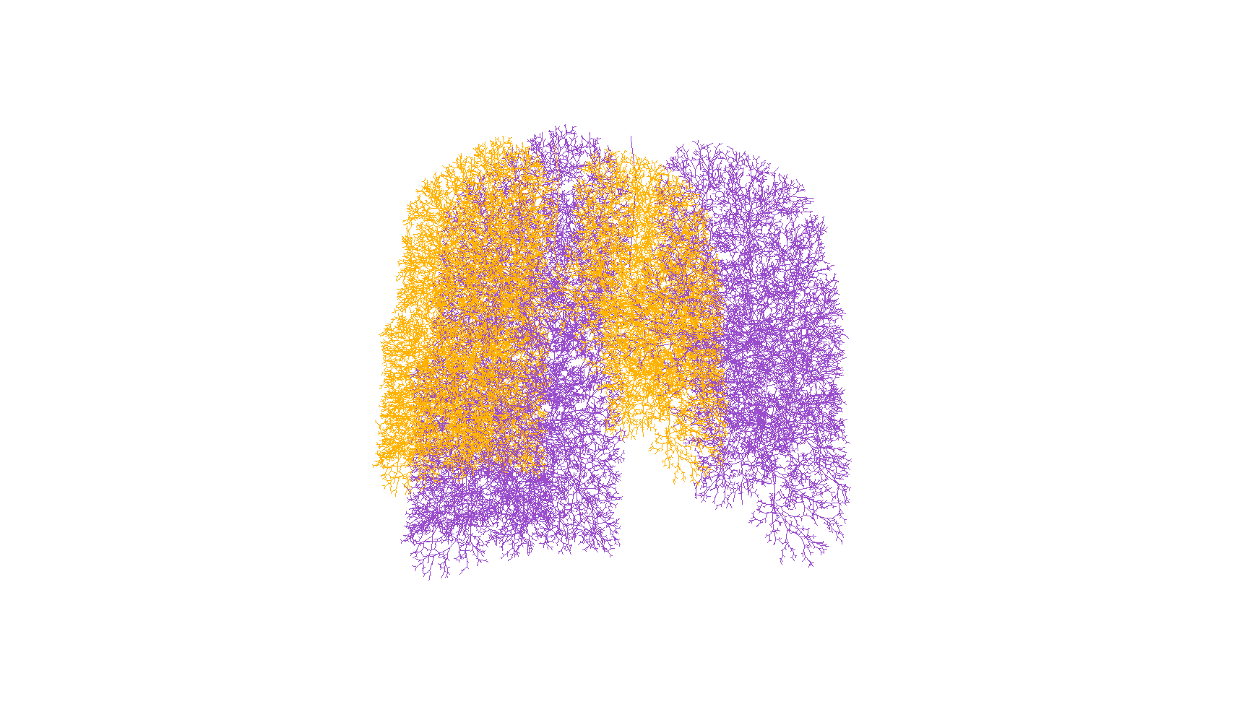
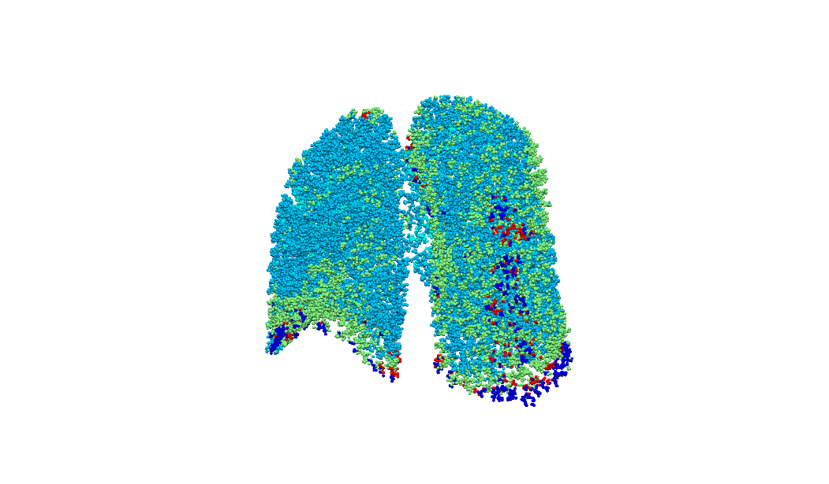
IPF patient-specific airway tree geometry
Manually digitize upper airway
Generate full airway tree of time point 1
Map first airway tree to other time points
Disease spatial distribution
Disease percentage against gravitational height
Scale the airway tree (length and radius) to FRC volume
Label each terminal acinar unit with different CT patterns
Notes:
In the next stage, our work is to use the previous quantitative CT based analysis on our computational models. Before that, a patient-specific airway tree geometry is needed. Firstly, the upper airway tree was manually digitized. Then, generate full airway tree of the first time point, map this airway tree to the lung volume mesh of other time points. Next, the airway tree terminal acinar unit was labelled with different CT disease patterns. After that, scale the airway tree, from image volume to its FRC volume.

Slide 12
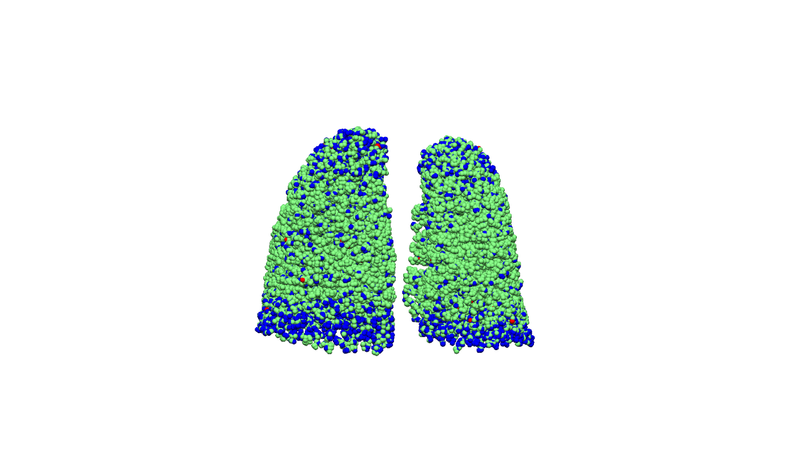
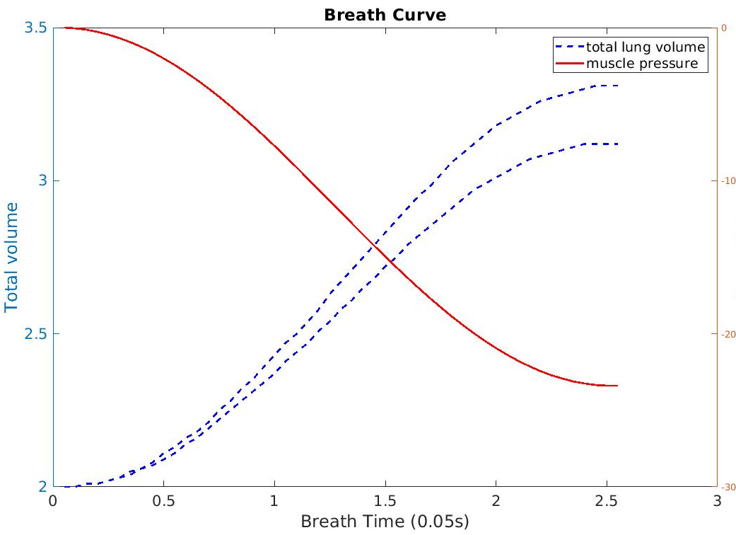
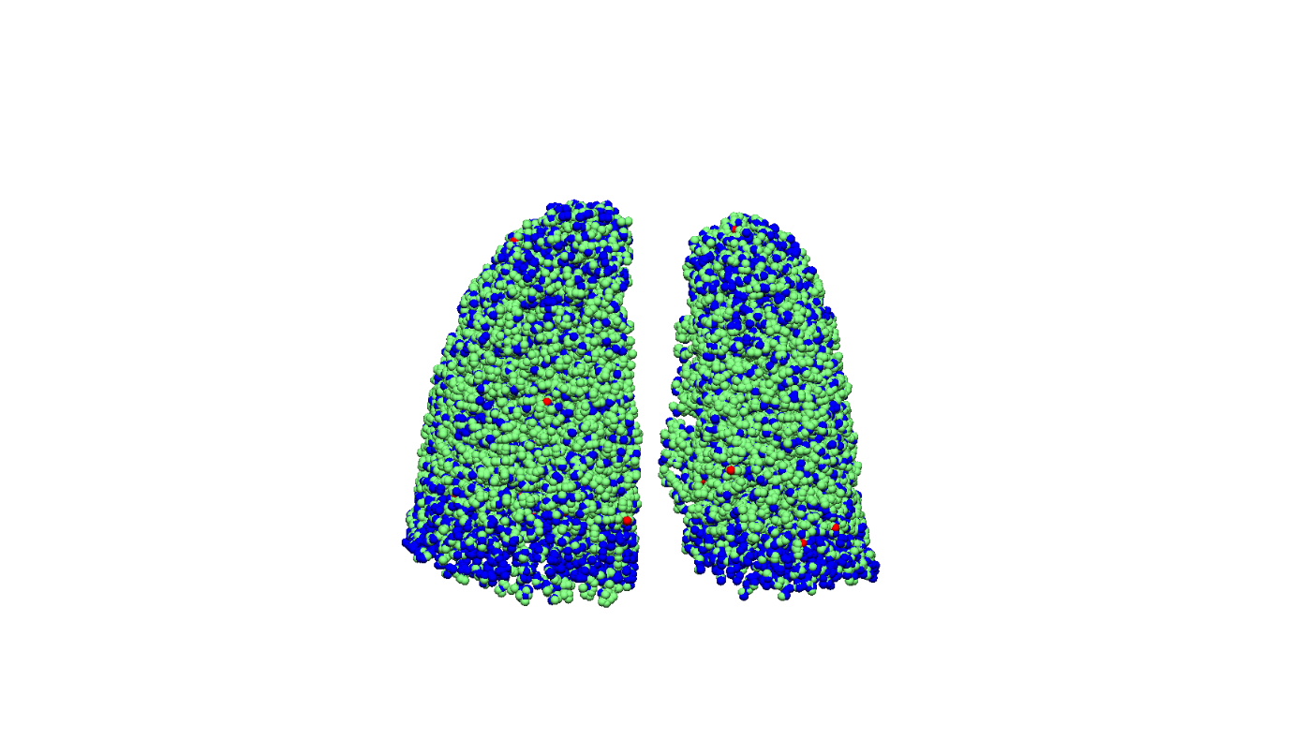
IPF patient-specific ventilation analysis
Forced inspiration
Reference FRC –TLC: set muscle pressure
Real FRC –TLC: set real abnormality distribution
Abnormalities on CT scan derived curve
Real inspiration curve
Fibrosis: 17.64%(from CT)
abnormalities on volumetric data are not sufficient to explain increased lung stiffness
Fibrosis: 29.75%
Notes:
With the labelled and scaled airway geometry, we used our ventilation model to simulate forced inspiration from FRC to TLC. Simulate forced inspiration from reference normal FRC to TLC to set a drived muscle pressure, then usethis muscle pressure to drive the disease forced inspiration on real FRC to TLC. Here, we decreased the compliance of the disease labelled acinar unit into a very small value, in order to make sure the disease region is stiff enough. We found, for most subjects, the fibrosis area extracted from CT image is not sufficient to match the real inspiration curve. There should be some CT “normal” tissues actually become stiffer and abnormal in IPF lungs.

Slide 13
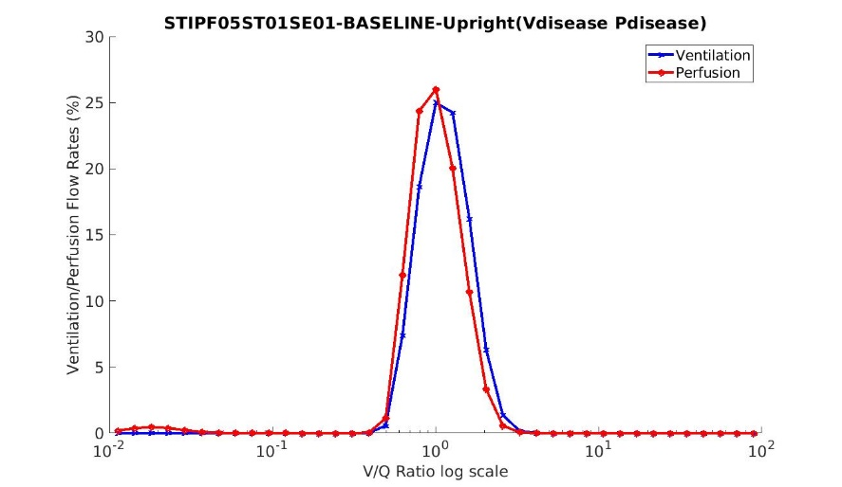
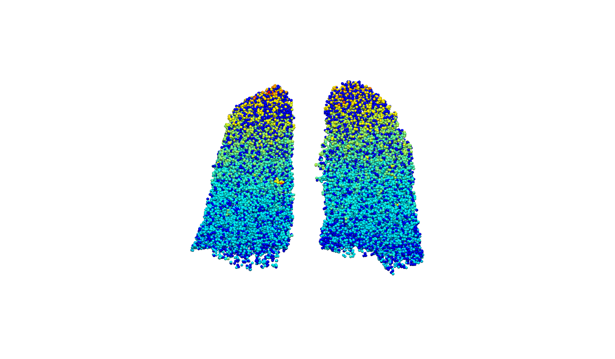
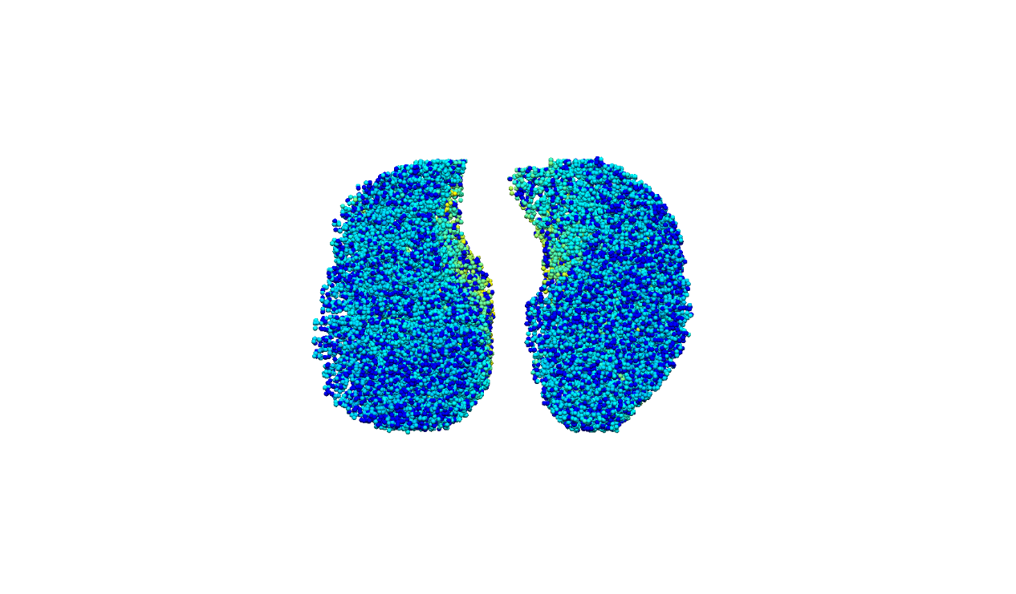
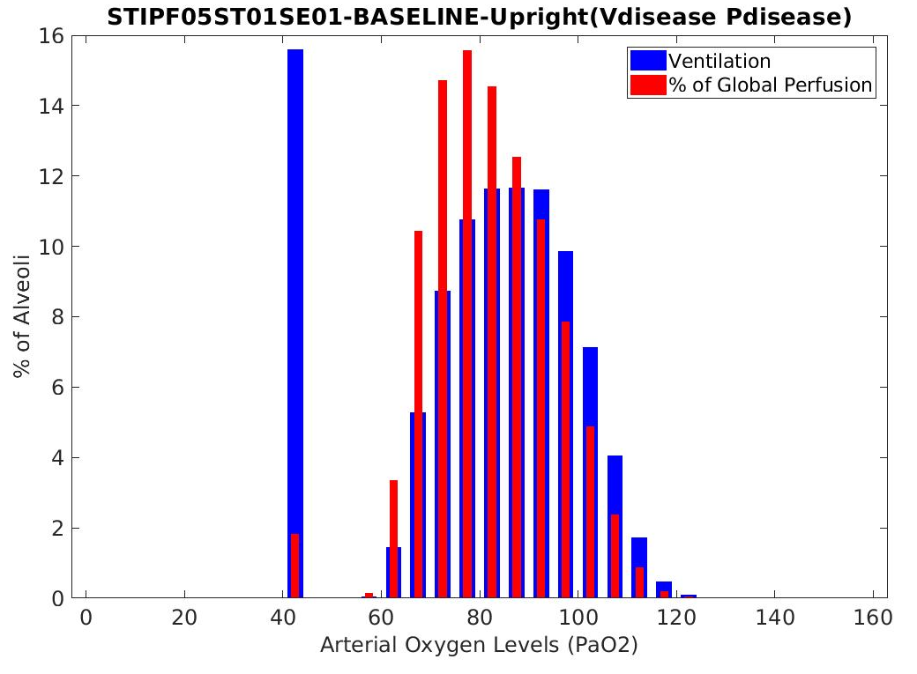
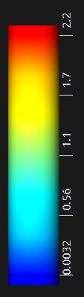
IPF patient-specific gas exchange analysis
Perfusion analysis:
parameterize the model inputs
generate vessel geometry
reduce the vessel radius of disease labelled region
V/Q ratio distribution
Notes:
For the patient-specific perfusion analysis, we generated the full vessel tree matching and surrounding by the airway tree. The vessel radius of the disease labelled region were decreased so that we can get a reduced perfusion of the abnormal regions. Using the ventilation and perfusion as input of the gas exchange model, we can get a V/Q ration distribution of IPF patient. We can observe from the result that V/Q mismatching could occur not only around the disease location but also happen on normal region. Currently we are still working on this part, more factor need to be taken into consideration, which leads to our future work.

Slide 14
Conclusion
Combine quantitative characterization extracted from volumetric CT with PFTs to parameterize the computational model
Simulate basic lung function
Shape difference between IPF lungs and old normal lungs (PCA based SSM)
The decline of lung function could not be fully explained by radiological tissue abnormalities

Slide 15
Thank you

